Slide 1
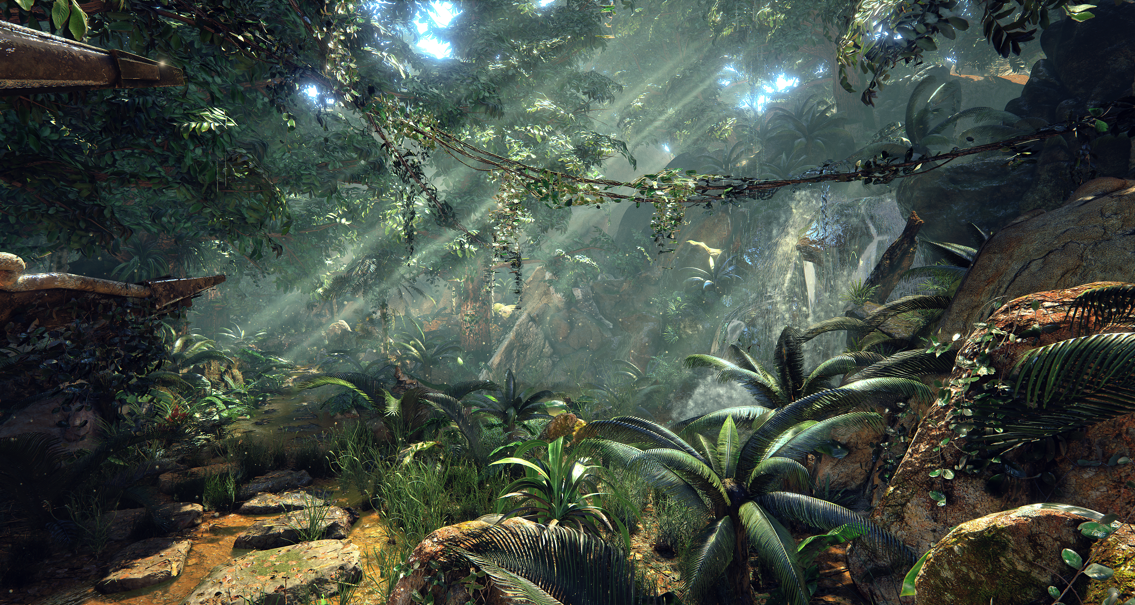
NextGen Software Ltd & Our World
Together We Can Create A Better World

Slide 2
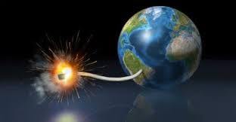
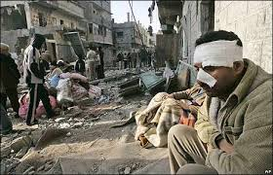
What’s the Problem?
Take a good look at the world we live in today, wars, poverty, famine, financial crisis, global warming, environmental disasters, race tensions, inequality, broken homes, crime, murders, stress, cancer, mental illness all at an all time high. The list goes on and on. Yes the world is in a crisis and we need to start taking responsibility for our beautiful planet before it is too late.
People learn at a young age how to act and behave and this shapes the future generations and the world they will create. Due to the majority of games these days involving violence, sex, drugs & crime, this is conditioning the youth of today to the sort of world they will create tomorrow. With the advent of Virtual Reality now making these violent games even more immersive and realistic where the boundaries between games and reality is shrinking by the day, it is imperative we take some social and moral responsibility and start using technology to help create a better world by improving people’s life’s as well as respecting the environment and the planet that sustains us.
People especially the youth are glued to their devices more and more and are having less and less real life face to face interactions. They also do not get out and play in parks and get some much needed fresh air!

Slide 3

Our Solution
The software industry has the power to transform lives through engaging people with innovative products that help them to grow and develop. Recent popular examples include health apps, mindfulness apps and mind training games.
We wish to take this to the next level and help make the world a better place by using technology for good, by bringing people together and to support, guide and educate everyone on how we can all live happier, fulfilling lives and at the same time how we can help save our planet.
We will do this by creating a suite of next gen apps & games using the latest cutting edge technology such as Virtual Reality, Augmented Reality, Real-time emotional feedback, face/voice recognition, motion detection and so much more.

Slide 4
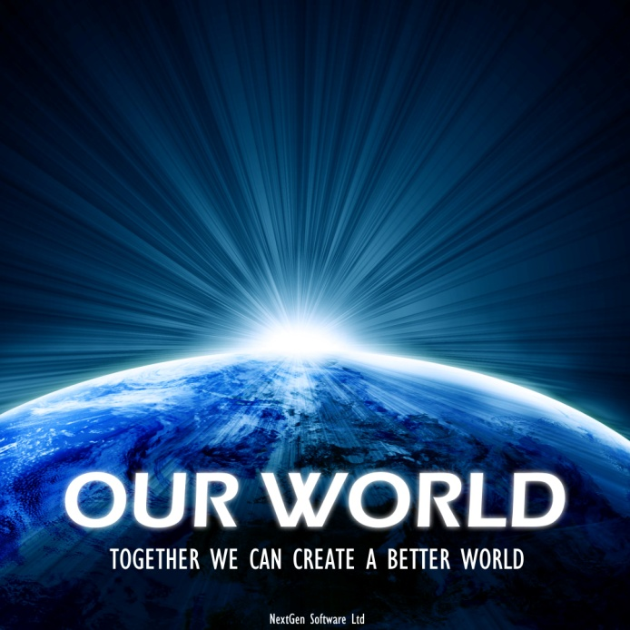
Our World
The Game That Will Change The World
Our World is a exciting next-gen 3D XR/IR (Infinite Reality) Game/Platform/Social Network/Operating System/App Store/Asset Store/E-commerce teaching people the importance of looking after themselves, each other and the environment using the latest cutting edge technologies such as Virtual Reality, Augmented Reality, Emotional Feedback, Voice Recognition & Motion Detection. Imagine World of WarCraft, MineCraft, Pokemon Go combined and then evolved 20 years into the future but was also aimed at the upliftment of humanity and you still are not getting close to what Our World is.
We wish to reach the kids who are glued to their phones and consoles and never go outside, this game will encourage them to get out into parks and interact with people in fun creative ways face to face instead of through their phones. It teaches people the importance of real-life face to face connections with human beings and encourages them to get out into nature using Augmented Reality similar to Pokémon Go but on a much more evolved scale. This is our flagship product and is our top priority due to the massive positive impact it will make upon the world...

Slide 6
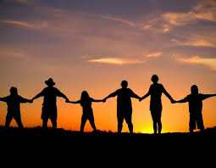
Our World
Bringing People Together
We wish to bring people together, build online communities, encourage people to reach out and help strangers for the greater good of all. To encourage people to come and work together and to show how everyone benefits if they put their differences aside and start all rowing together. It will model the real world and also act as a simulation and training environment for how to make the real world a better place.
We are building the evolved benevolent version of the OASIS featured in the popular Ready Player One novel & Spielberg film.
Gamified decentralised distributed crowd-sourced 3D Google Maps/Google Earth replacement with geolocation quests and AR mode that comes alive when people start doing quests in their local parks/nature
Encourages team work exercises such as treasure hunts and building sacred geometry and so much more!

Slide 7

Our World
XR Gamification Layer Of The New Internet
It is the XR/IR Gamification layer of the new interplanetary operating system & the new internet (Web 3.0+), which is being built by the elite technical wizards stationed around the world. This will one day replace the current tech giants such as Google, FaceBook, etc and act as the technical layer of the New Earth, which is birthing now.
Unlike the current tech giants who's only aim is to ruthlessly maximize profits at the expense of people and the planet (as well as spying, exploitation, censorship & social engineering), our technology is based on true love & unity consciousness where money and profits are not our aim or intention (but it will still make billions!), our aim and intention is to heal the entire planet & human race so we can all live in harmony with each other. It is a 5th dimensional and ascension training platform, teaching people vital life lessons as well as acting as a real-time simulation of the real world.
Our World is built on top of the de-centralised, distributed nextgen internet known as Holochain, which will one day make Blockchain obsolete.
Our World will be the first AAA MMO game and 2D/3D Social Network to run on HoloChain and the Blockchain. It will also be the first to integrate a social network with a MMO game/platform as well as all of these technologies and devices together. As with the rest of the game, it will be leading the way in what can be done with this NextGen Technology for the benefit and upliftment of humanity.

Slide 8
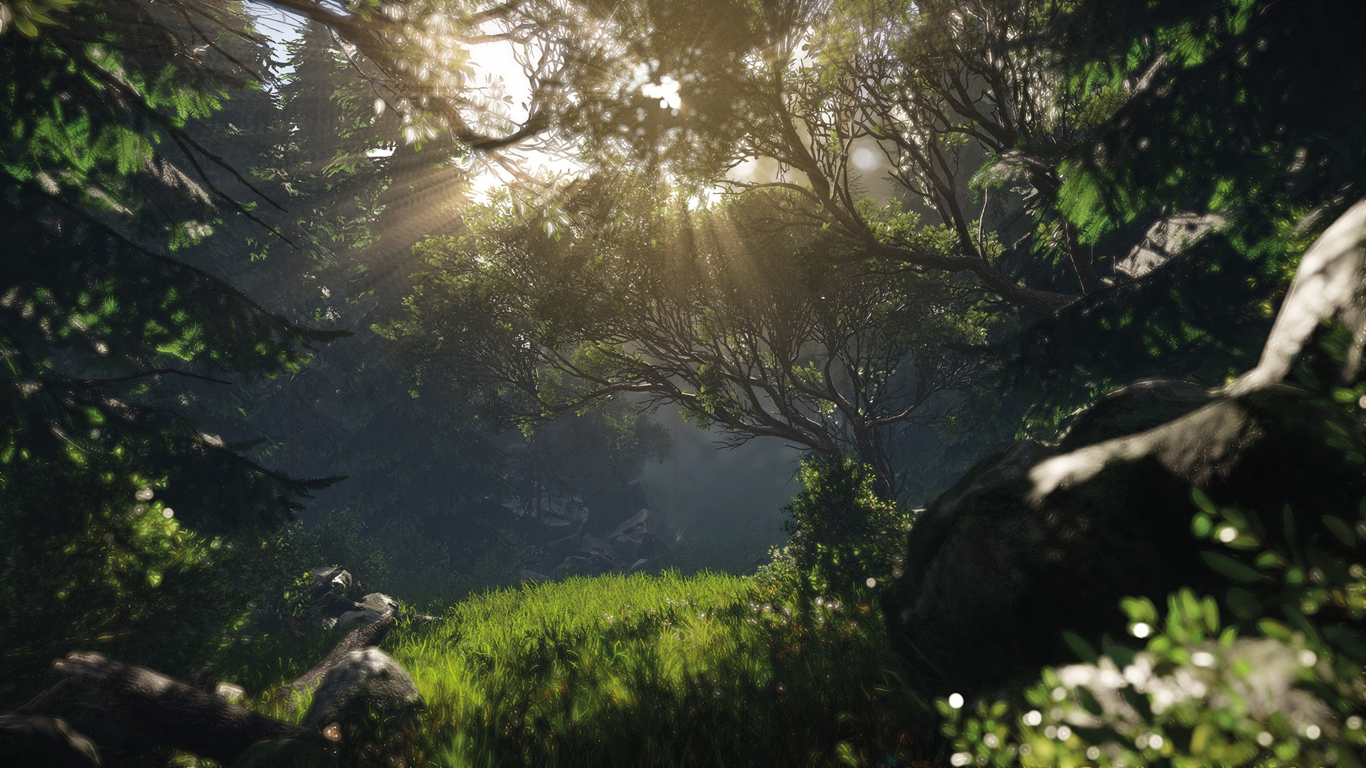
What’s the Problem?
Take a good look at the world we live in today, wars, poverty, famine, financial crisis, global warming, environmental disasters, race tensions, inequality, broken homes, crime, murders, stress, cancer, mental illness all at an all time high. The list goes on and on. Yes the world is in a crisis and we need to start taking responsibility for our beautiful planet before it is too late.
People learn at a young age how to act and behave and this shapes the future generations and the world they will create. Due to the majority of games these days involving violence, sex, drugs & crime, this is conditioning the youth of today to the sort of world they will create tomorrow. With the advent of Virtual Reality now making these violent games even more immersive and realistic where the boundaries between games and reality is shrinking by the day, it is imperative we take some social and moral responsibility and start using technology to help create a better world by improving people’s life’s as well as respecting the environment and the planet that sustains us.
People especially the youth are glued to their devices more and more and are having less and less real life face to face interactions. They also do not get out and play in parks and get some much needed fresh air!

Slide 9
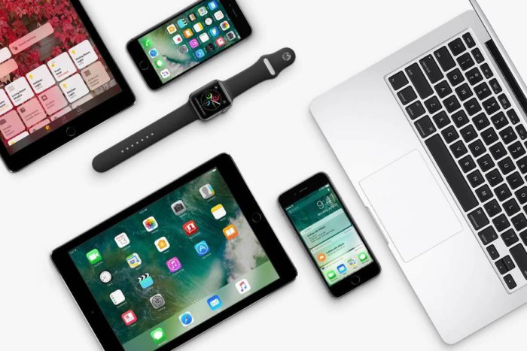
Our World
Smartphone & Desktop/Console Versions
The smartphone version will be a geolocation game featuring Augmented Reality similar to Pokemon Go but on a much more evolved scale (yes, we were designing this long before Pokemon Go came out!).
The console/desktop version will be similar to a Sandbox and MMORPG (Massive Multiplayer Online Role Playing Game) but will be nothing like any other games such as World Of WarCraft & MineCraft. It will in fact define its own genre setting the new bar for others to follow, this truly has never been done before and will take the world by storm! The one thing it will share with them is that it will be a massive open world that billions of players can explore and build together...
Both versions will share the same online world/multiverse where users logged in through the smartphone versions will be able to interact with the console/desktop versions in real-time within a massive scale persistent Multiverse.
As well as smaller apps/games being allowed to plug into Our World either sharing just the central avatar/profile (data) or full UI integration, content creators/businesses can also create shops (where people can purchase real items in VR that are then delivered to your door so in effect is virtual e-commerce), buildings or even entire zones/lands/worlds. They can rent virtual spaces within the game. Please contact us on ourworld@nextgensoftware.co.uk if you wish to receive special early adopter discounts...

Slide 10

Our World
Karma Is The Future Currency
Businesses can also sponsor or advertise in the game but unlike traditional models, money does not buy you the best spots, the companies collective karma does. The greener & the more they do good for the world including giving to charities, looking after their employees, the environment, etc the more karma they get. Advertising spots will be limited since we do not wish to bombard users with adverts so this will be an incentive for companies worldwide to improve and start focusing on what is important, and that's people and the environment, not money. As may be clear by now, the focus and goals of Our World is to create a better world, not to make as much money as possible. But we of course will still make more than enough (billions) to continue to expand & grow, the rest will go to good causes and charities such as our sister company Yoga4Autism.
Our World reminds people how powerful they are and empowers them to be the person they have always wanted to be, to live their life to their FULL potential without any limitations. Everyone has a gift for the world and with Our World we can help them find it. We want to empower people to take responsibility for our beautiful planet, which is currently in crisis and so needs EVERYONE to help make a difference. The entire world is the Our World team, we want everyone to get involved so they can feel they are part of something greater than themselves and at the same time ensure there is a future for our kids and grandkids.

Slide 11

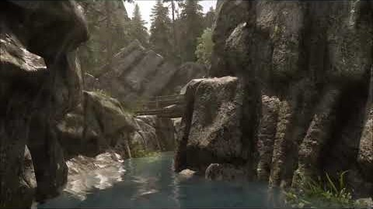
Our World
The Game That Will Change The World

Slide 12
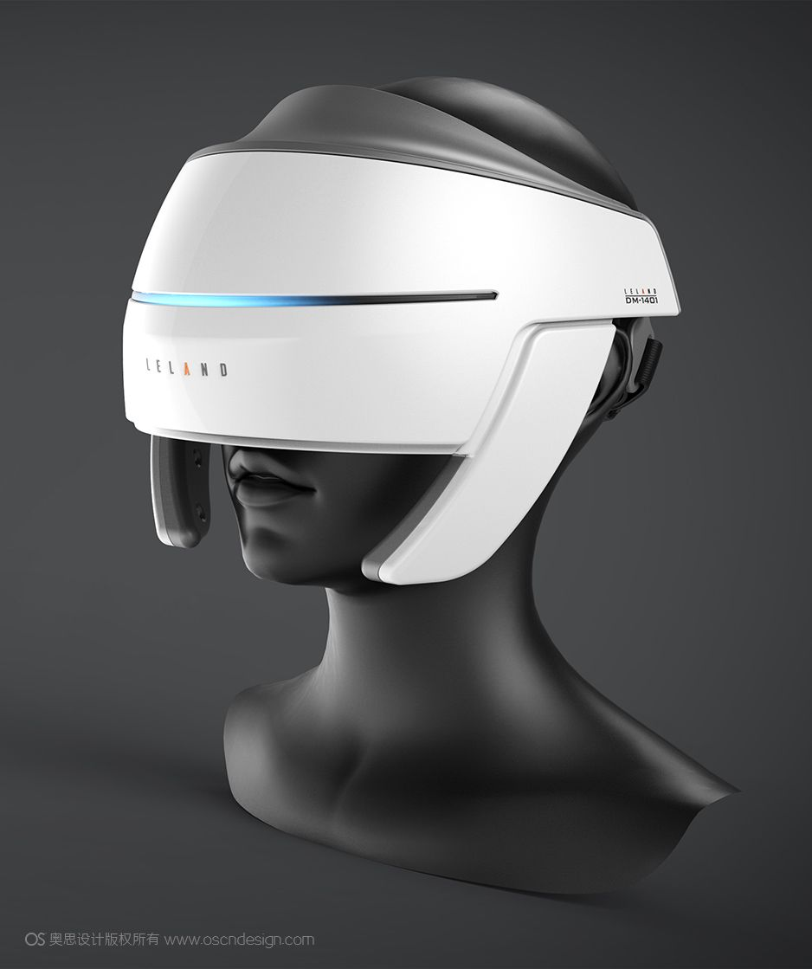
Our World
NextGen Hardware
Our World will use the latest next generation technology. Some of the hardware we will be pushing to the limits is below:
Augmented Reality
Magic Leap
Microsoft HoloLens
Google Glass
Google Tango
Apple ARKit
Google ARCore
Others
Virtual Reality
Oculus Rift
HTC Vive
Samsung Gear VR
Samsung Odyssey VR
PlayStation VR
Others
Emotional Feedback:
NeuroSky/MyndPlay
Others
Motion Detection/Voice Recognition/Eye Tracking:
Kinect
Leap Motion
Others
Haptic Feedback:
​Hapto VR
* If you check out the demos of the above, you will start to get an idea of the apps & games we are building. However, of course we are pushing these to the next level by building the next generation apps & games for today. The game is much bigger than just a game, it is more like a massive educational platform, with a LOT more revolutionary ideas, which at this time we cannot make public.

Slide 13
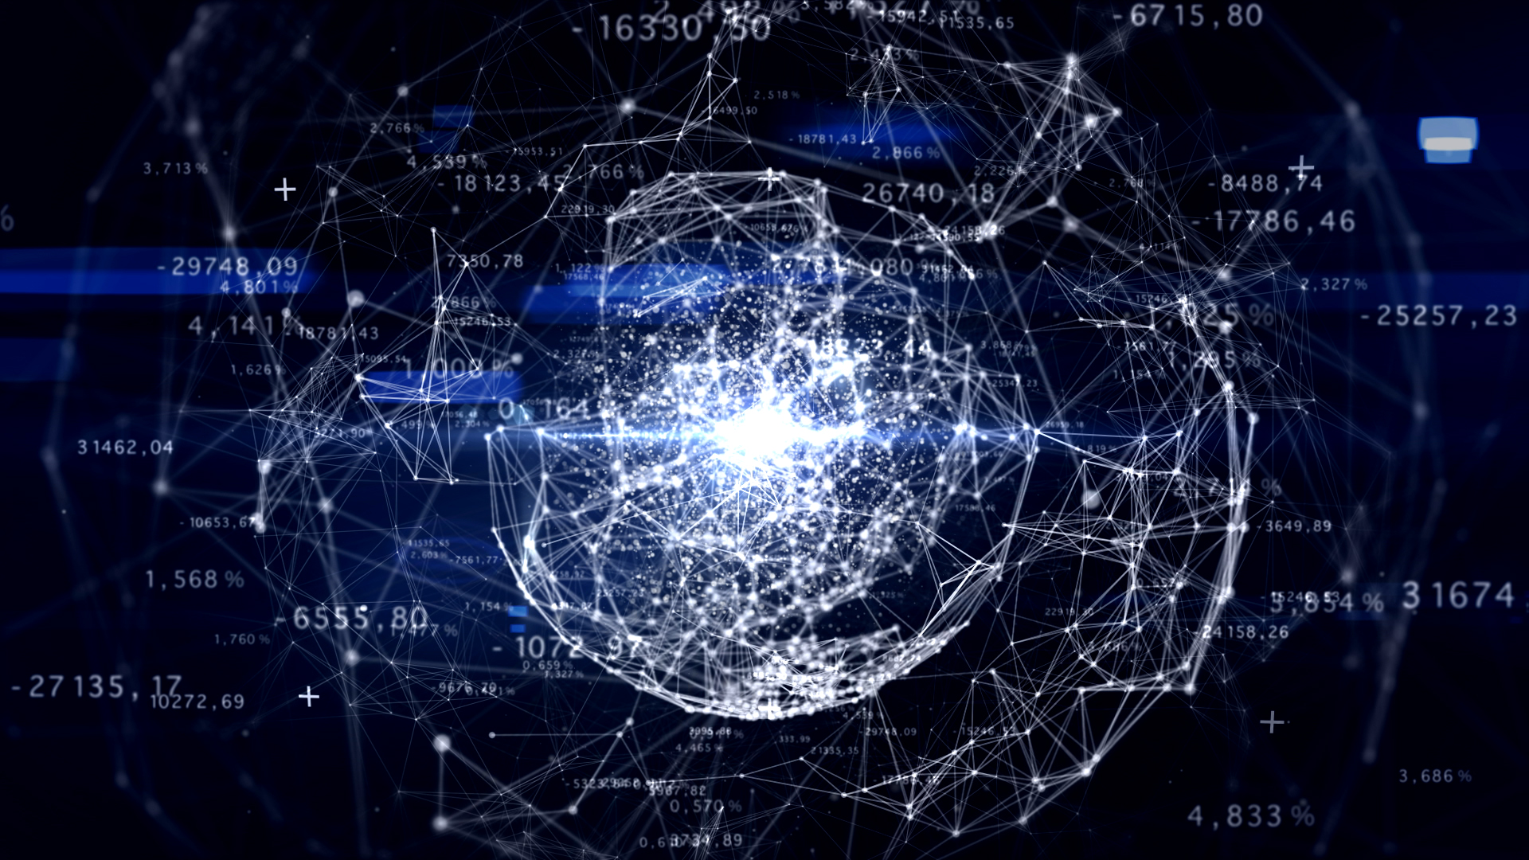
Our World
NextGen Architecture
Our World will run on our own propriety game engine called OASIS 2.0 (Open Advanced Sensory Immersion System).
​Our World will run on a secure, distributed and de-centralized architecture where user’s data will be stored on their machine and not a central server enabling the user to own their data, meaning it cannot be sold or exploited as others do. It will do this by running on a new nextgen Internet known as Holochain.
​Our World will run on its own private secure network called ONET (OASIS Network) on top of HoloChain offering yet more security and performance benefits. It will not suffer from any bottlenecks as is the case with the current centralised server architecture in current games causing lag, which is very frustrating to gamers and can mean life or death in games.
​Our World/OASIS & ONET can even distribute the computing power across the gamers machines so if some machines are struggling, they can borrow processing power from fellow gamers with more powerful rigs (if they give permission of course!). Sounding like the OASIS from Ready Player One (book version) yet? ;-)

Slide 14
Our World
NextGen Architecture
It will also run on IPFS, the Ethereum blockchain, DAOStack ARC, H4OME & many more…
It will act as the bridge between all the upcoming nextgen technology as well as supporting legacy systems until they are also migrated to the new nextgen internet.
​All of these apps that plug into the OASIS API (Our World) will be known as OApps (OASIS Apps). As well as these OApps be able to share their data/UI with any other OApp, they can also take advantage of the OASIS Asset Store where users can buy various add-ons for your app/game.
By supporting everything Our World/OASIS will help act as a bridge between the old and the new world.
​NextGen Software & Our World themselves will also be a DAO (Distributed Anonymous Organisation) registered with DAOStack meaning we can self-govern and cut out the expensive middlemen such as banks, lawyers, accountants, managers, contracts etc. This technology will allow us to realise our long-held dreams of running a flat decentralised organisation where every voice is heard, respected and is counted as an equal. This also prevents fraud, mistakes and corruption from occurring as is all too common now days.

Slide 15
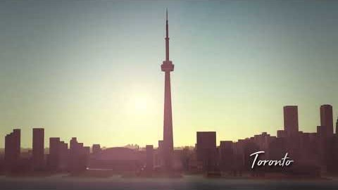
Our World
The Game That Will Change The World

Slide 16

Our World
Open Source & Open Community Project
The games source code is Open Source meaning the community can help design and develop Our World, empowering them that they are really contributing to something that will help make the world a better place.
Our GitHub Repo is already gaining traction and has 10 people who have stared it along with 246 commits in 3 branches.
It includes more technical details of the vision & project as well as technical documentation of what has been built so far.
Check it out here: https://github.com/NextGenSoftwareUK/Our-World-OASIS-API-HoloNET-HoloUnity-And-.NET-HDK
This is a project for the community by the community. We are always open to ideas and constructive feedback. We believe in people power, this is a vital project for the world and it is powered by the people. We want to empower people and communities to come together and feel like they have contributed something towards making the world a better place, together we can create a better world…
Please send ideas and feedback to ourworld@nextgensoftware.co.uk, if you wish to help contribute to the code we would also LOVE to hear from you! ☺

Slide 17
The OASIS API
The World’s Universal API - Connecting Everything To Everything…
Architecture that powers Our World.
We believe that the OASIS API & Karama System should be baked into the core of the new internet (Web 3.0) that we are co-creating and will allow Everything to talk to Everything else and will act as the worlds universal API/protocol. At the center of this is the central profile/avatar where the user's data will be stored. Part of this data will include the karma they have earnt in Our World as well as the karma they have earnt in any of the inter-connected satellite apps/games that use the OASIS API.
Abstraction layer over the entire internet, a network of networks.
Connects all current & future protocols, API’s, networks & platforms including all Blockchains, Holochain, ActivityPub, SOLID, IPFS, Gab, Mastodon, Diaspora, WebFinger, CEPTR Pluggable Protocol, Ethereum, Fediverse, XMPP, Legacy and so much more!
Removes silos & walled gardens.
Rather than trying to compete, it includes & integrates EVERYTHING.
It is Unity Consciousness expressed within the technical sphere.

Slide 18
The OASIS API
The World’s Universal API - Connecting Everything To Everything…
Shares the central profile/avatar/karma system within Our World with the satellite apps/games/websites that plug into it forming the Our World ecosystem. People can earn karma by doing good deeds within the apps/games/websites such as volunteering or donating to charities, helping people or nature or by progressing in self help apps/games/websites such as mindfulness & meditation apps/websites/games.
The player levels up the more karma they collect unlocking special abilities & super powers such as flight, teleportation, telekinesis & so much more!

Slide 19
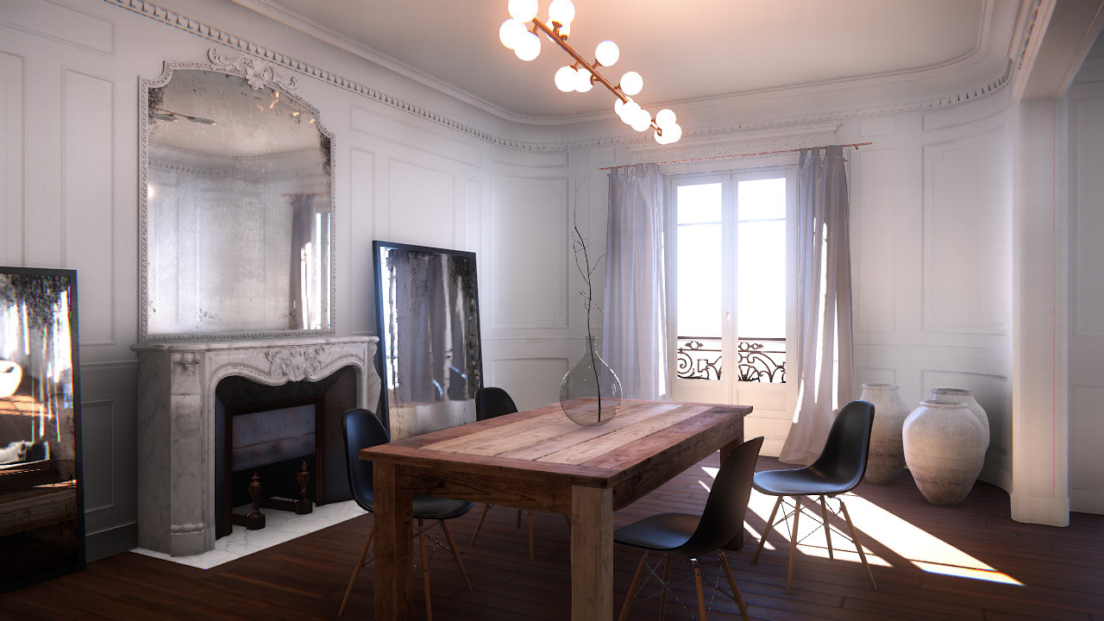

Slide 20
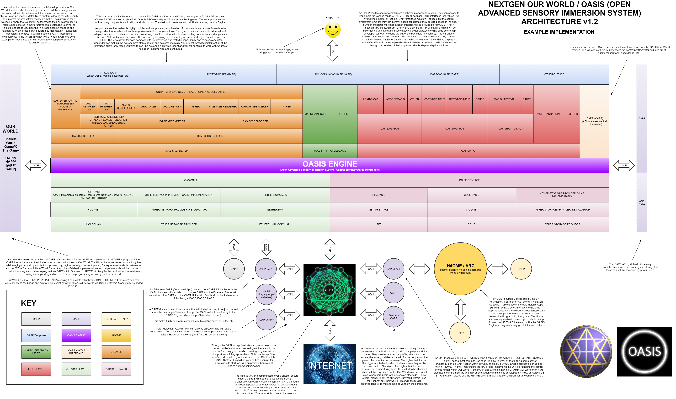

Slide 21
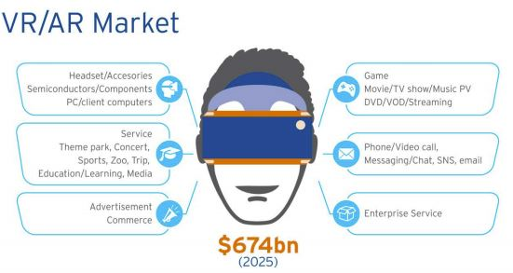
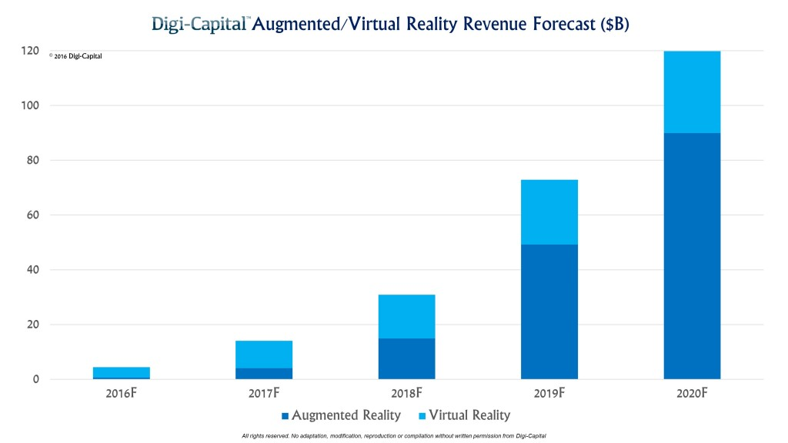
The Market
Our target market is everyone who plays video games or uses apps on their phones or consoles. We also hope to even pull people in who currently do not.
Over 2.52 billion people currently play games and 2.32 use apps rising to 2.87 billion by 2020.
The software development market in the UK alone is worth £22bn with an annual growth of 4.7% between 2012 and 2017.
According to the latest research the VR/AR Market is set for VERY explosive growth with estimates of $674bn by 2025.

Slide 22
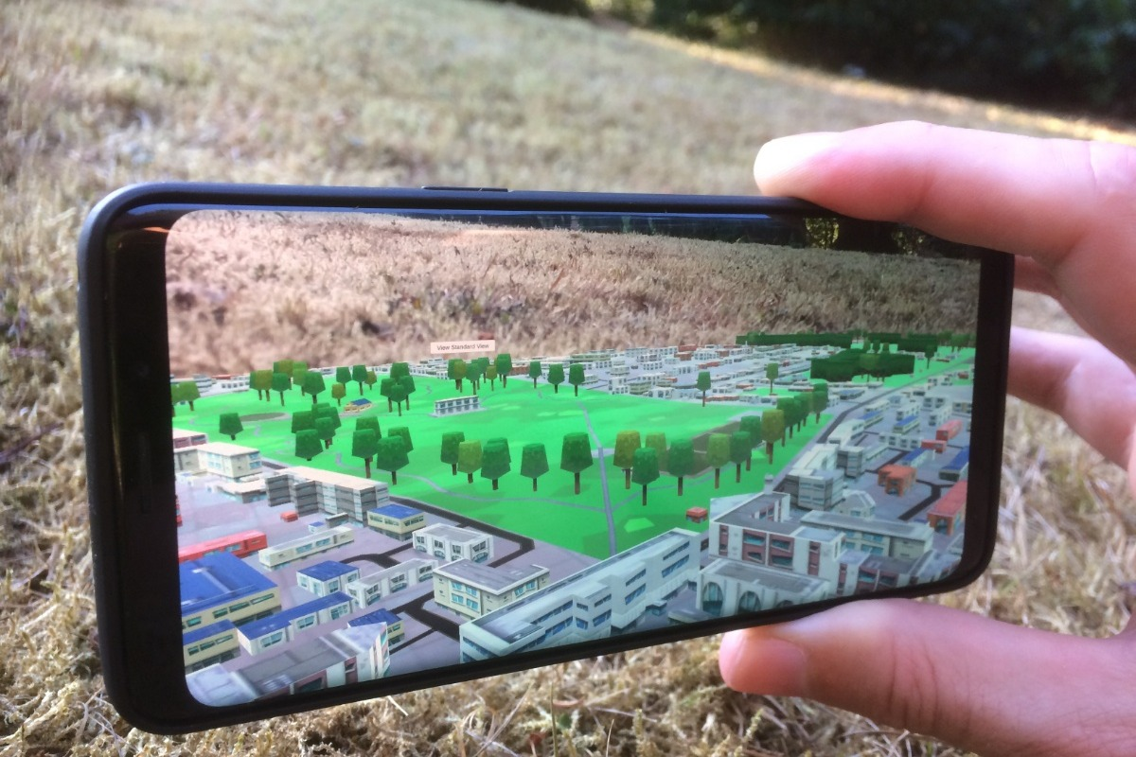

Slide 23



Business Model
Virtual Space Hire
Businesses can rent virtual space, which they can then build virtual shops or anything else they wish. Consumers can then make purchases in these virtual shops, these goods can then be shipped to them in real life. So they act like virtual 3D websites.
Sponsorship
Businesses can also sponsor various items in the game such as Samsung Body Armor or Holland & Barret Mega Healing Potion.
They may also possibly advertise on virtual billboards and side of buildings, etc.
In-Game Purchases
Users can find various items in the game but they can also purchase additional items from virtual merchants for a small fee in real money similar to how many other games now work but we will not use loot boxes since we do not wish to encourage gambling as others do.

Slide 24
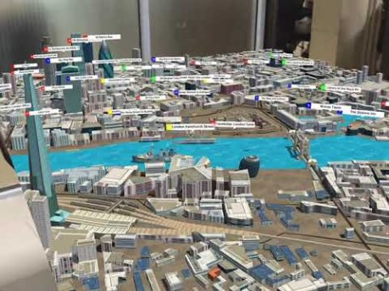
Our World
The Game That Will Change The World

Slide 25
Roadmap & Traction
2010
NextGen Software Ltd Created.
2011
Planning, Research & Design Initiated.
2012
Tech R&D Initiated. First XNA Prototype created of 3D World.
2013
Business Plan V1 Completed & Yoga4Autism Ltd Created.
2014
Business Plan V2 Completed & Early Prototypes Developed.
2015
Continued To Build Team, Ideas, R&D, Networking, etc.
2016
FB Page, Twitter Account, Website, Blog & Forum Created.
.
2017
Prototype 1 & smaller apps/games development initiated & 5000 FB Likes Reached.

Slide 26
Roadmap & Traction
2018 Q1
3D World map implemented for Smartphone Prototype.
2018 Q3
Our World website evolves & blogs hit 30.
2019 Q1
AR mode implemented for Smartphone Prototype.
2019 Q2
Holochain (decentralized distributed network/internet that powers Our World) connected to Unity (World First!) within the Smartphone Prototype.
First version of user's avatar/profile implemented in Smartphone Prototype.
2019 Q3
Our World featured in Key Apps & Partners section on new Holochain Forum.
HoloNET (world’s first .NET client for Holochain that connects Our World to Holochain) featured in Holochain’s Dev Pulse 44 Newsletter (with over 50k subscribers).
Our World partners with Sacred Capitial where their Reputation Interchange will help power the Karma System within Our World & the OASIS API.
OASIS API first release nears completion allowing satellite apps/games to plug into Our World sharing the central profile/avatar/karma system. The OASISAPI also connects all networks (including all Blockchains), platforms, API’s & protocols together so acts like an abstraction layer over the whole internet, a network of networks.

Slide 27
Roadmap & Traction
2020 Q1
Smartphone Prototype Altha Released.
2020 Q2
Console Prototype Development Initiated.
2020 Q4
Smartphone Prototype Beta Released.
2021 Q4
Smartphone Phase 1 Released.
Console Prototype Proof Of Concept Released.
2022 Q4
Smartphone Phase 2 Released.
Console Prototype Altha Released.
2023 Q4
Smartphone Phase 3 Released.
Console Prototype Beta Released.
2024 Q4
Smartphone Phase 4 Released.
Console Phase 1 Released.
2025 Q4
Smartphone Phase 4 Released.
Console Phase 1 Released.
Planet saved, mission accomplished, put the kettle on & celebrate at the world party.

Slide 28
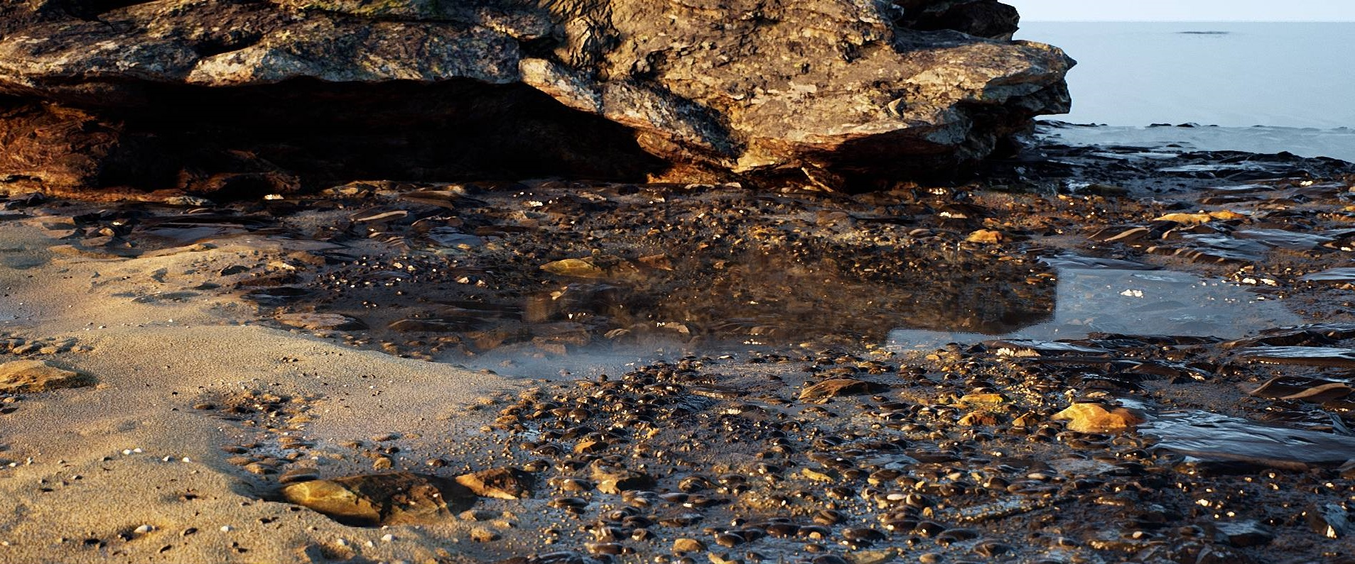

Slide 29
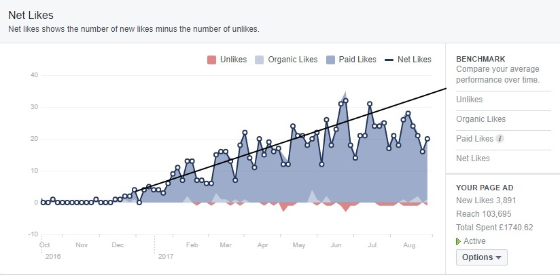
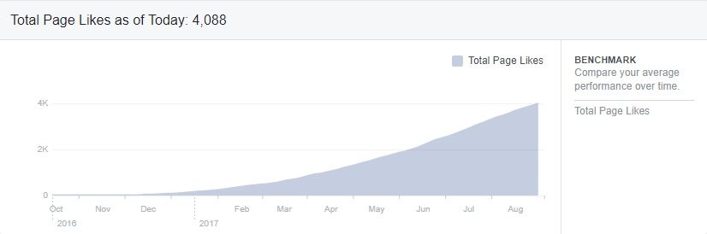
Roadmap & Traction

Slide 30

Marketing and Sales
Our marketing strategy is to build a brand recognised for educational, fitness, well-being, health & spiritual software to help make peoples lives’ better. Our additional focus on Special Needs and teaching the importance of looking after our environment will help to bolster our brand. As the world wakes up to the fact that we need to start focusing on healing the planet before it is too late, they will start to reprioritise peoples wellbeing and the environment before all else resulting in the demand for our products to increase exponentially leading to explosive growth.
Just some of the techniques we will use include: Social media, books, articles, mags, newspapers, word of mouth, promotion on app/games stores (Microsoft, Apple, Android), online/TV advertising, banners, leaflet distribution in educational establishments, partner web advertising, online and offline advertising within the spiritual & educational sector, exhibitions and trade shows, meetings with schools to include in curriculum activities, leverage of network, training course users, promotion through charities, PR resulting from training course, public talks which David already does and will also be doing TED talks very soon, David has extensive spiritual networks who will help aggressively market and promote all of his products since they are just as passionate as David is about making the world a better place. With people waking up to climate change, this only helps the boost the demand for Our World and our products.
Our recruitment plan includes the appointment of a professional in the marketing industry to build on our marketing strategy. We expect to recruit this person from our network or via our investors.

Slide 31
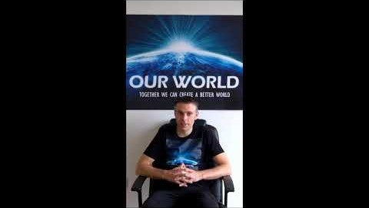
Our World
The Game That Will Change The World

Slide 32

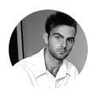
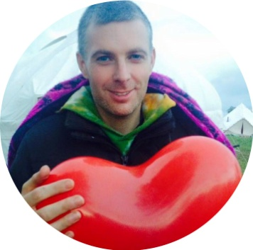
The Team
David Ellams BSc(Hons)
Founder/MD/Senior Developer/Architect
Elizabete Baptista
Strategy Advisor
Alex Panteli
Sales Manager/Game/App Designer
David has been programming since the age of 8, when he got his first computer, the good old ZX Spectrum, ever since then he has been hooked to coding, especially games. As well as creating games, he has enjoyed playing them his whole life. He has vast experience in all things technical including coding websites, desktop software, back-end services, apps, games and much more as seen on his CV. He has a 1st class honors degree in Computing And Informatics and came top of his class. He is rated as one of the top contractors in London. He has always had a passion for computing but later in life he realised the world really was not in a good way and wanted to use his skills to make a real difference so he created NextGen Software Ltd to create revolutionary cutting edge apps & games to help make the world a better place. Our World is his masterpiece and has been in the design stage for over 6 years but now the time is finally here to make his dream a reality...
Elizabete is a good friend of David's and is a qualified and professional coach/mentor, author, healer, sociologist and has 32 years of vast experience in the corporate world in the fields of Strategy & Organizational Development , Change & Transformation dynamics ,Innovation and Communication, Leadership and Coaching.
Alex is also a good friend of David’s and is an experienced salesman and has been selling products and services his entire life (over 20 years). He is also a very keen gamer and has excellent game designing skills.

Slide 33
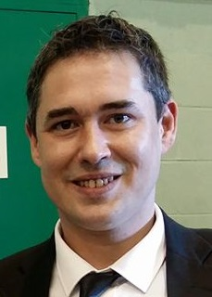


The Team
Stephen Watts
Creative Solutions Manager / Technician / Lead Game Designer
Sam Parker
Fitness & Training Manager
Martin Schiller
Programmer
Stephen has been best friends with David since they were very young, he like David has always had a passion for computers, programming & gaming. He is also very good at the hardware side of things and has been playing around with electronics since an early age. He is an excellent sounding board for David and has been helping to design Our World and other NextGen apps. Together they make a good team bouncing advanced very far out ideas of each other, dreaming of the day when they could make them a reality, that time has now arrived. He has also been involved with Yoga4Autism.
Sam has just left the armed forces a hero after doing two tours in Iraq and one tour in Afghan. He is also a fitness instructor and a very successful boxer. He is a very bright young man with a lot of ideas as is the case with the rest of the team above. He now wants to get into programming so he will be one of the first people to take the course. He also states that everyone in the army wants to now become a programmer too, so this is yet another golden opportunity. We will be creating an army of developers out of the army, our marketing pitch will be along the lines of "Put your guns down, pick up your keyboards and make peace, not war." Since remember all of our products are aimed at helping people and the environment making the world a better place for all. He also has good contacts both within the army and Help for Heroes, which will make maximum use of for marketing our developer training programme.
Martin was born in Munich, but after 10 years he left Germany and lived another 8 years in Malta. He got interested in the digital world at a young age and started to learn programming at the age of 14. He experimented with many different programming languages including python, java, ruby, lua, javascript, haxe, dart and used various 2D game frameworks such as openfl, love2d, pixijs and haxeflixel.
* We have a number of other team members, please check the website & Business Plan to view them. We have people joining our talented team all of the time who are inspired and motivated by our vision.

Slide 34
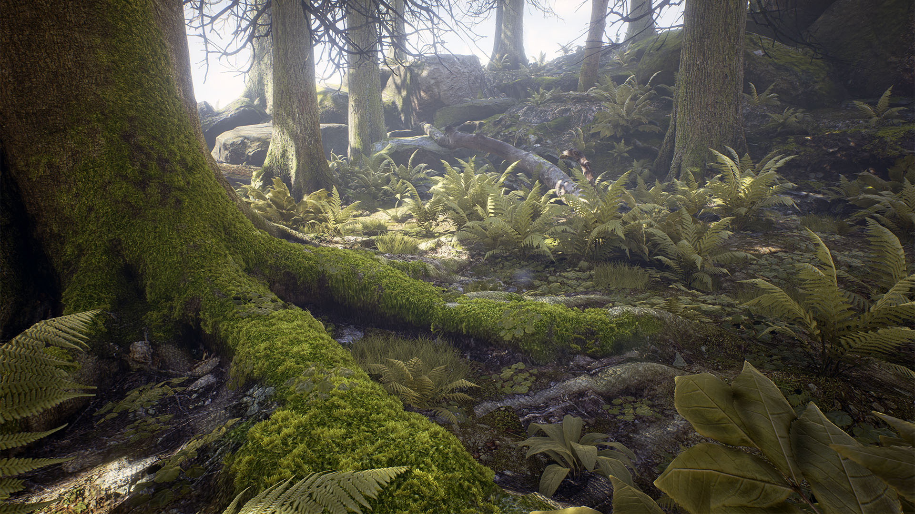

Slide 35
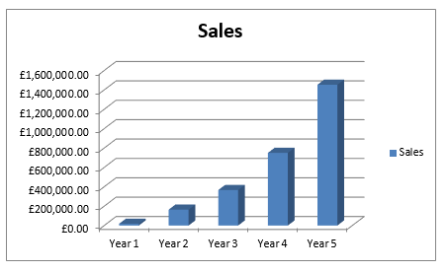
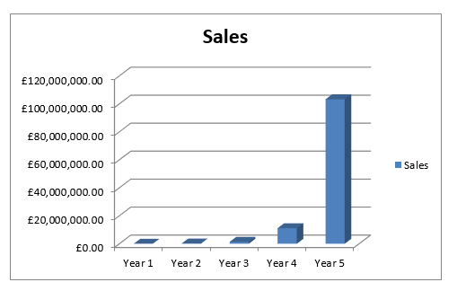
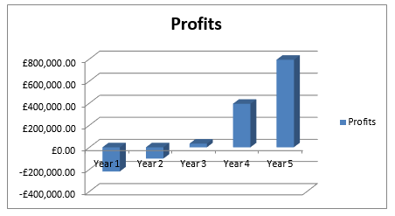
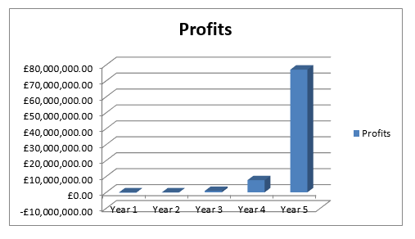
Financials
Conservative
Optimistic

Slide 36
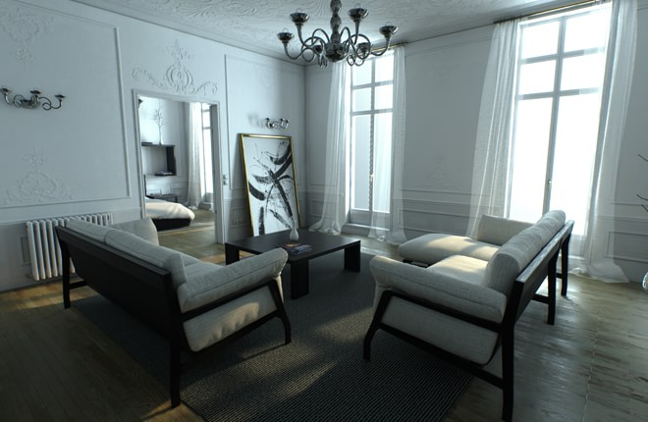

Slide 37






Competitors
Our main competitors are Microsoft, Apple, FaceBook, Google, Mojang and Blizzard. We are aware of our competitors’ strengths and weaknesses and can learn from areas where they have not been successful such as:
  Pokémon’s rapidly declining users due to lack of engagement & immersion.
  Security risks of Pokémon and Ingress
  Facebook selling peoples private data and lack of transparency, which people are becoming less and less happy about.
  Google also collecting peoples private data.
Our major competitors all use very similar strategies, which is why we are guaranteed to succeed due to our strategy being completely new and original. We will be the only software company who focuses completely on the wellbeing/spiritual/environment arena.
Our training course allows us access to the brightest minds (autism) meaning that we will be highly competitive with our vast developer resource. Our founder, David Ellams has already demonstrated his abilities, often creating software for his previous private clients before finding that, years later, similar programs have been developed by Google and are now in everyday use. One example is the search suggestions in Google and YouTube.
The fact that we are a small, dynamic organisation is in our favour as we are able to adapt quicker. Large corporations take time to adapt and respond. This provides us with an advantage to disrupt the market.

Slide 38
Use of Funds
The shareholder makes regular investments to the business in order to continue development but in order to drive the business forward, the business requires a minimum of £300,000 to expand. The investment will go towards getting a prototype developed for Our World so we can then attract further investment.
It will also go to the development costs of a number of smaller apps & games we have planned, which will in turn integrate into Our World. They will also be released before Our World and so will also help cover the development costs of Our World.
Approximately £20,000 will go to the smaller apps & games and the rest to Our World.
We are also looking for £300,000 for Yoga4Autism either as a separate investment or as part of this one. We will be developing a more detailed separate plan for Yoga4Autism later if it is needed.

Slide 39
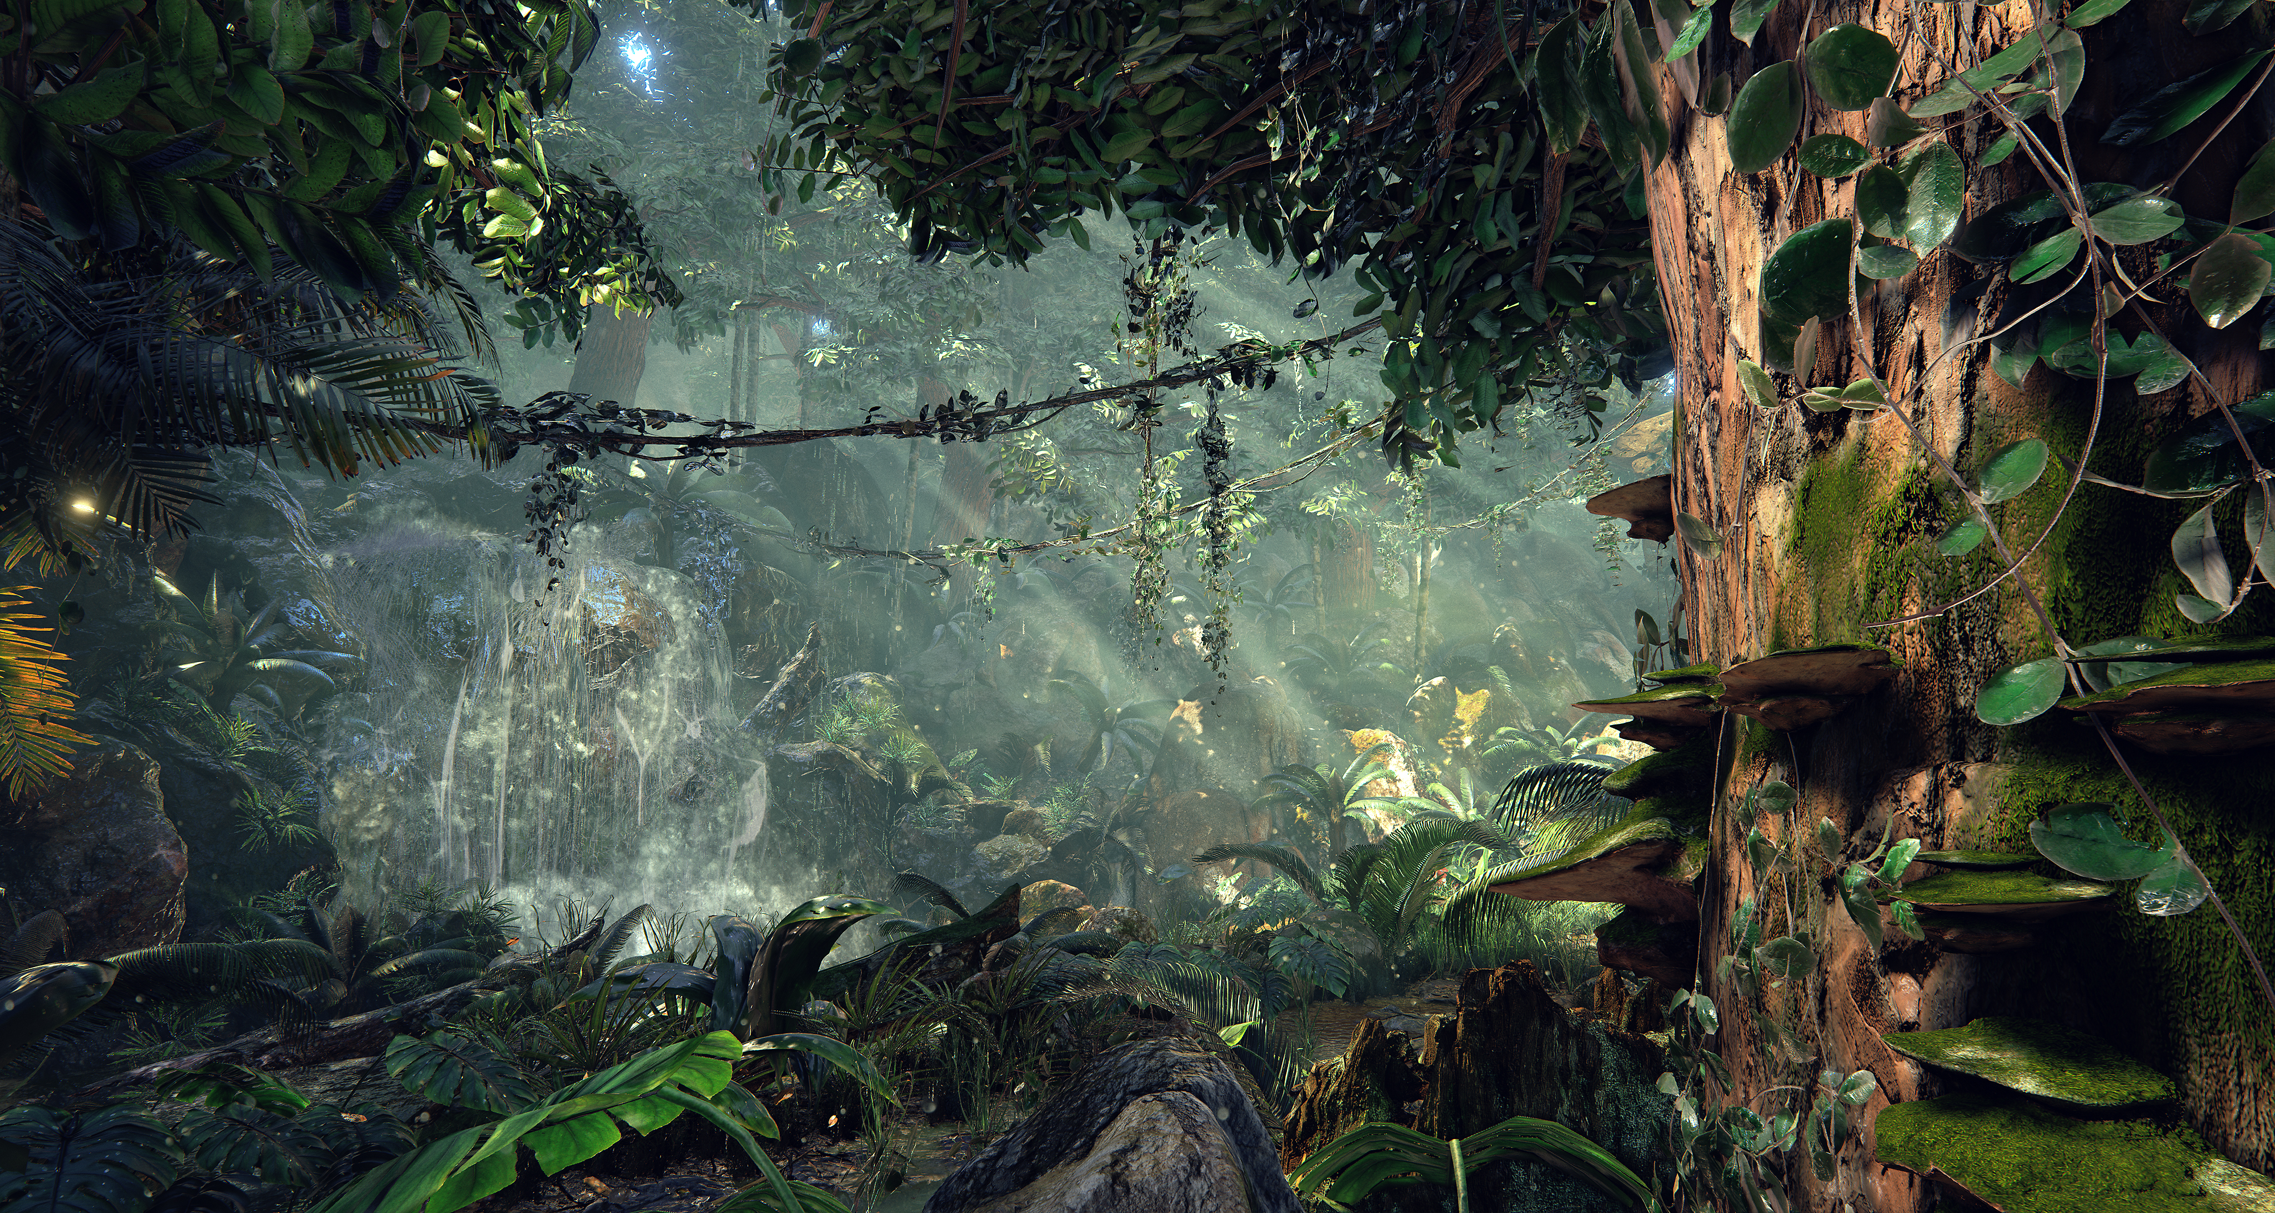

Slide 40

Golden Opportunity For Investors
​You have the opportunity of the lifetime to get in on the ground floor for what is to become a leading industry in the future world that is birthing now. Everywhere people are now looking at ways in how they can do their bit to make this world a better place. By supporting this ground breaking project you will not only be doing your bit and leaving your mark on the world, but you will also be recognised as one of the founders of a game so epic that really will help change the world. This is not just trend setting and leading the way, this is a whole new way of being, the way of the future... so choose to be part of it or be left behind. You will of course profit immensely from this investment, we predict this game will be worth billions in the future...
​We aim to be the next Microsoft, Google, Apple and Facebook. That is how big our vision and ambition is! The difference is all our profits will be used to help make the world a better place and not for selfish gain...
​But at the end of the day, it is important to remember that it doesn't really matter how much money you make or horde if there is no planet left to enjoy or spend it...

Slide 41
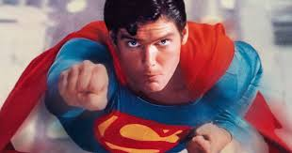
What Will Be YOUR Legacy?
What mark do you want to leave on the world? What do you want to be remembered for? Leave a better world to your kids and grandkids. Leave a legacy you will be proud off, and in doing so give the next generations a brighter future...
The game will teach people how to care for our world and look after the environment in fun and entertaining ways. It will tackle the environmental crisis we are currently facing such as plastic pollution, endangered animals, oil spills, fossil fuels, fracking, rainforest's etc.
​It will teach people to respect our beautiful planet that sustains us and to start prioritising people’s health and the environment above all else, our survival as a species depends on it…

Slide 42
